Slide 2
CLOUD SECURITY: Using Searching Techniques on Encrypted Data
Minor - II
Mid-Term Presentation
on
Project Guide
Ms. Tripti Misra
Assistant Professor(SS),
School of Computer Science (Department of Systemics)

Slide 3
TEAM MEMBERS AND ROLES
NAME | ENROLL NO. | ROLE
B R REHA | R134217046 | Coding, Implementation, Documentation
CHIRAG GOEL | R134217050 | Coding, Implementation, Documentation
DIVIJ BERRY | R134217055 | Coding, Implementation, Documentation
GAURAV RANA | R134217058 | Coding, Implementation, Documentation
Branch : B.Tech – Computer Science with specialization in Cyber Security and Forensics

Slide 4
ABSTRACT
We present a scheme that discusses keyword search over an encrypted stored data.
The data that has to be outsourced is encrypted using symmetric encryption algorithm for data confidentiality.
Encrypted file index and encrypted keyword index data files are generated, so that any untrusted user cannot access the data.
Whenever the user searches for a keyword the request is sent to the database and the indexed data is referred.

Slide 5
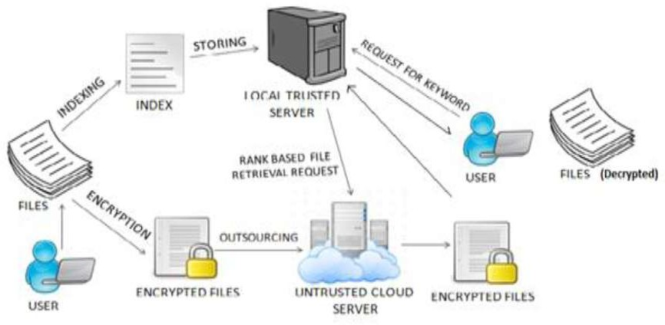
INTRODUCTION
If we need to perform a search over the encrypted data, we have two options:
We can download the entire data set, decrypt it and search it client-side.
We can give the remote server the secret key we used to encrypt the data and let the server decrypt and search it.

Slide 6
PROBLEM STATEMENT
Sensitive data is encrypted before outsourcing it and users have to decrypt the file before performing a search on it and searching particular data over encrypted data is a challenging task.

Slide 7
OBJECTIVES
Developing a website for keyword search over an encrypted cloud data.
Indexing of the keyword from the file
Searching of the file with a keyword on the local server
Implementation of AES symmetric key algorithm.

Slide 8
METHODOLOGY
Requirement analysis
Study of indexing techniques on encrypted data
Design
Implementation
Coding phase 1
Study of extracting keywords
Coding phase 2
Testing
Mid term Report submission

Slide 9
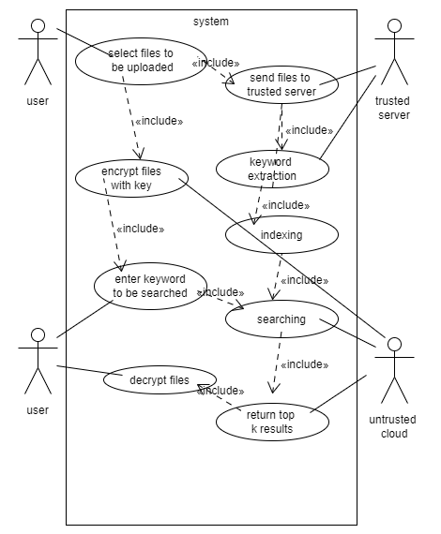
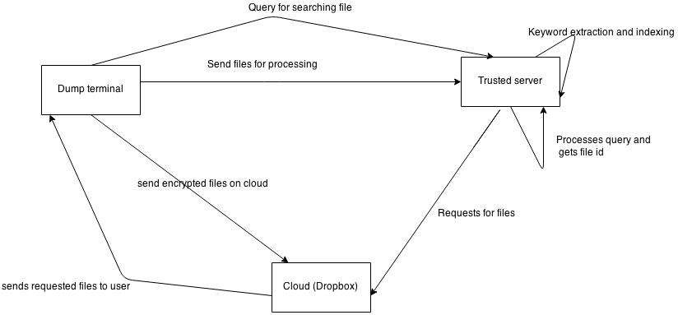
UML DIAGRAM BLOCKDIAGRAM

Slide 10
DESIGN METHODOLOGY
Encryption Algorithm AES
The figure AES-256 is utilized among different places in TSL/SSL over the Internet. It’s considered among the top figures.
In principle it's impractical to break it, since the blends of keys are enormous.
Propelled Encryption Standard guarantees security as well as improves the presentation.
AES is government data handling standard and there are as of now no known non brute power techniques for direct assaults against it.
AES is sufficiently able to be confirmed for use by the US government for top mystery data.

Slide 11
DESIGN METHODOLOGY(continued..)
PHP
The PHP Hypertext Preprocessor (PHP) permits web engineers to create dynamic substance which connects with databases.
Regular uses and attributes of php will be:
PHP performs framework capacities, handles structure. It can add, delete and update components in database.

Slide 12
DESIGN METHODOLOGY(continued..)
Keyword Generation
A simple key word generation algorithm in php that reads the entire file and delete all the stop words (like I, am, those, these… etc) and the remaining words are considered as keywords. The occurrence of each keyword is calculated and displayed as frequency of that particular character.
ALGORITHM: 1. Accept the string (file content) as an argument. 2. Remove unwanted characters: a. Remove punctuation characters b. Remove symbol characters c. Remove number characters d. Convert to lower case

Slide 13
DESIGN METHODOLOGY(continued..)
3. Process the whole page's words a. Split the text into a list of words b. Stem the words c. Remove stop words d. Remove unwanted words. e. Calculate frequency count of each keyword
4. The function returns the most commonly occurring words as an array, with the key as the word and the amount of times it occurs as the value. accordingly.

Slide 14
DESIGN METHODOLOGY(continued..)
Search Matching Algorithm :
1. Accept the multi-keyword query from the user. 2. Encrypt the query. 3. Extract the keywords using keyword extraction algorithm described above. 4. Match the keyword occurrences: loop through all keywords and check if they match any of the fields. 5. For every field that matches with our search term, give it a score, which will be used for ranking. 6. The files would be retrieved from untrusted cloud, based on the results derived from above steps. 7. The top-k files will be selected based on ranking function implemented by trusted server. 8. Decrypted files will be sent to the user.

Slide 15
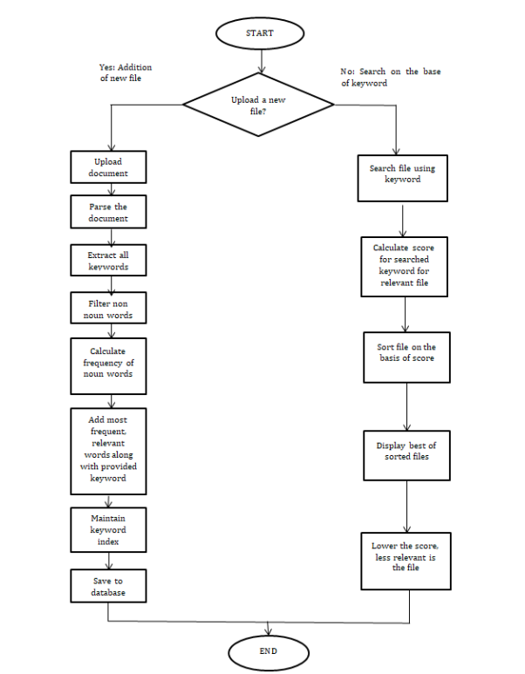
FLOW CHART

Slide 16
IMPLEMENTATION
The User selects a plain text files to upload. These files are then encrypted using AES 128 bit algorithm.
Following actions are performed at Trusted Server after it receives the encrypted file:
Keyword Extraction is performed.
Encrypted index table is generated and maintained.
To perform a search operation the user enters a multi keyword query which is then encrypted using AES 128 algorithm and keyword extraction is then performed.
Now these extracted keywords are matched against all the keywords in the database on the trusted server using pattern matching algorithm every matching keyword is then assigned a score used for ranking.
Based on these scores the top-k ranked files are determined and returned to the user by the untrusted cloud.

Slide 17
WORK STATUS
Task Achieved
Sample UI of the website
Upload of the text files
Keyword Extraction and encryption
Indexing
Task yet to be Done
Searching over the encrypted text
Additions on the UI

Slide 18
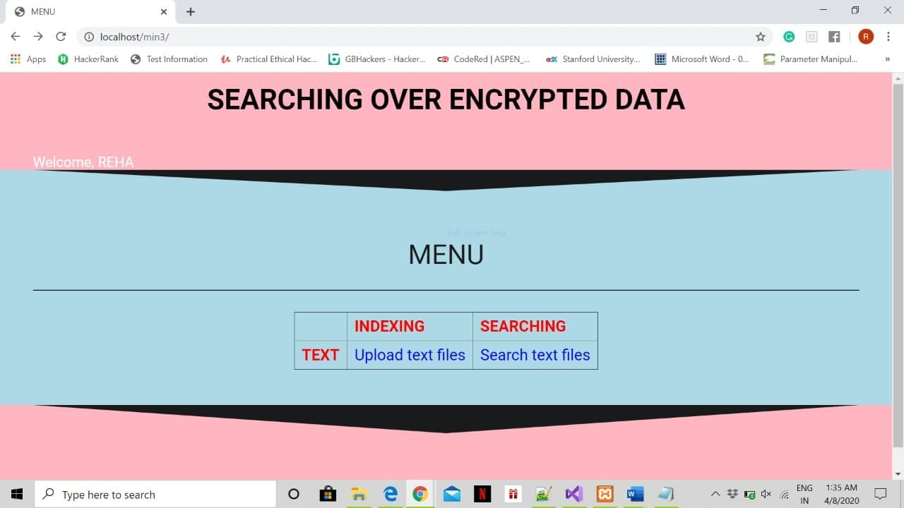
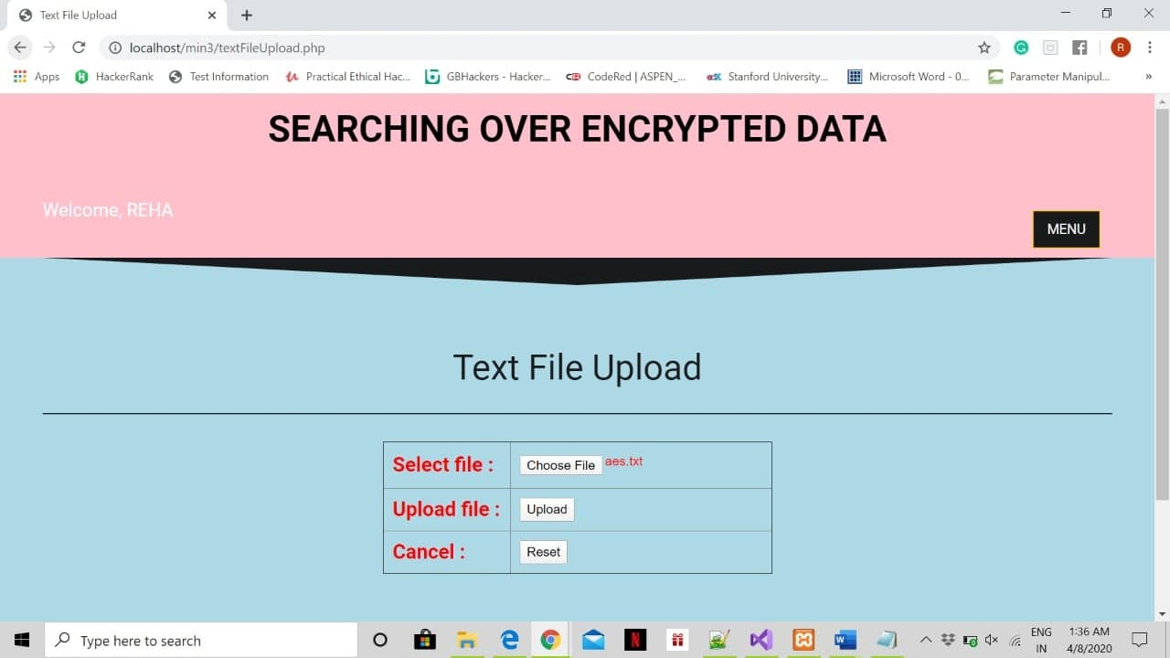
OUTPUT SCREEN
1.Index.php- It is the homepage which opens when you open the website, it has 2 options namely Text File Upload and Text File Search.
2.Textupload.php- It is the UI for uploading the file to be stored in database.

Slide 19
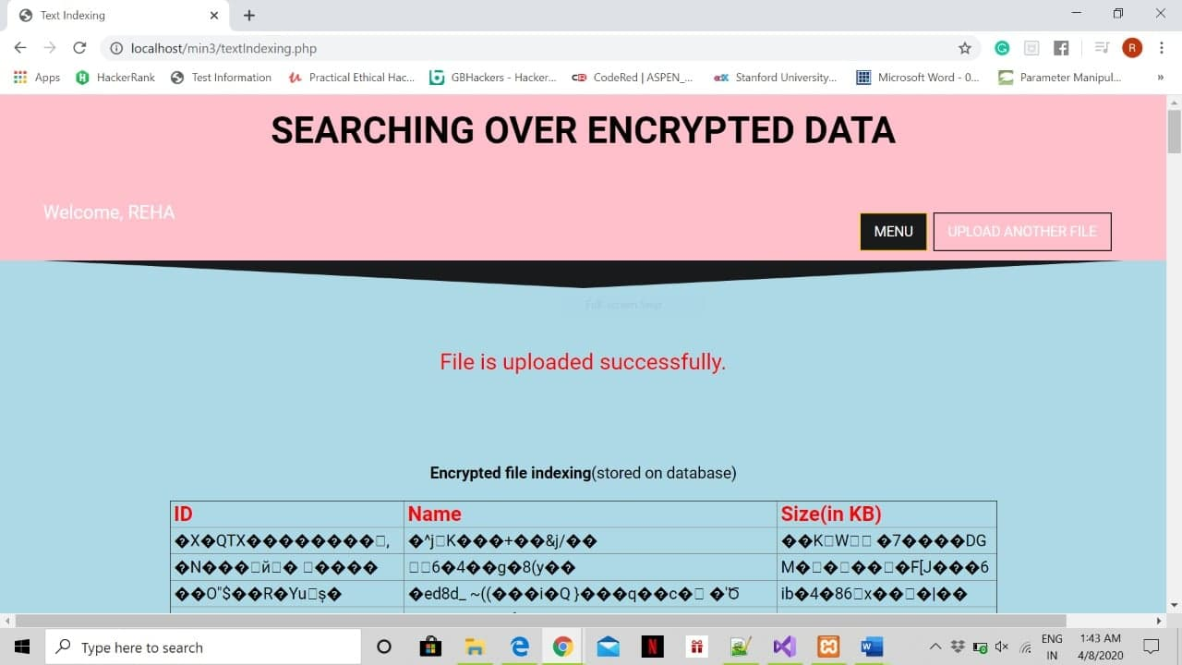
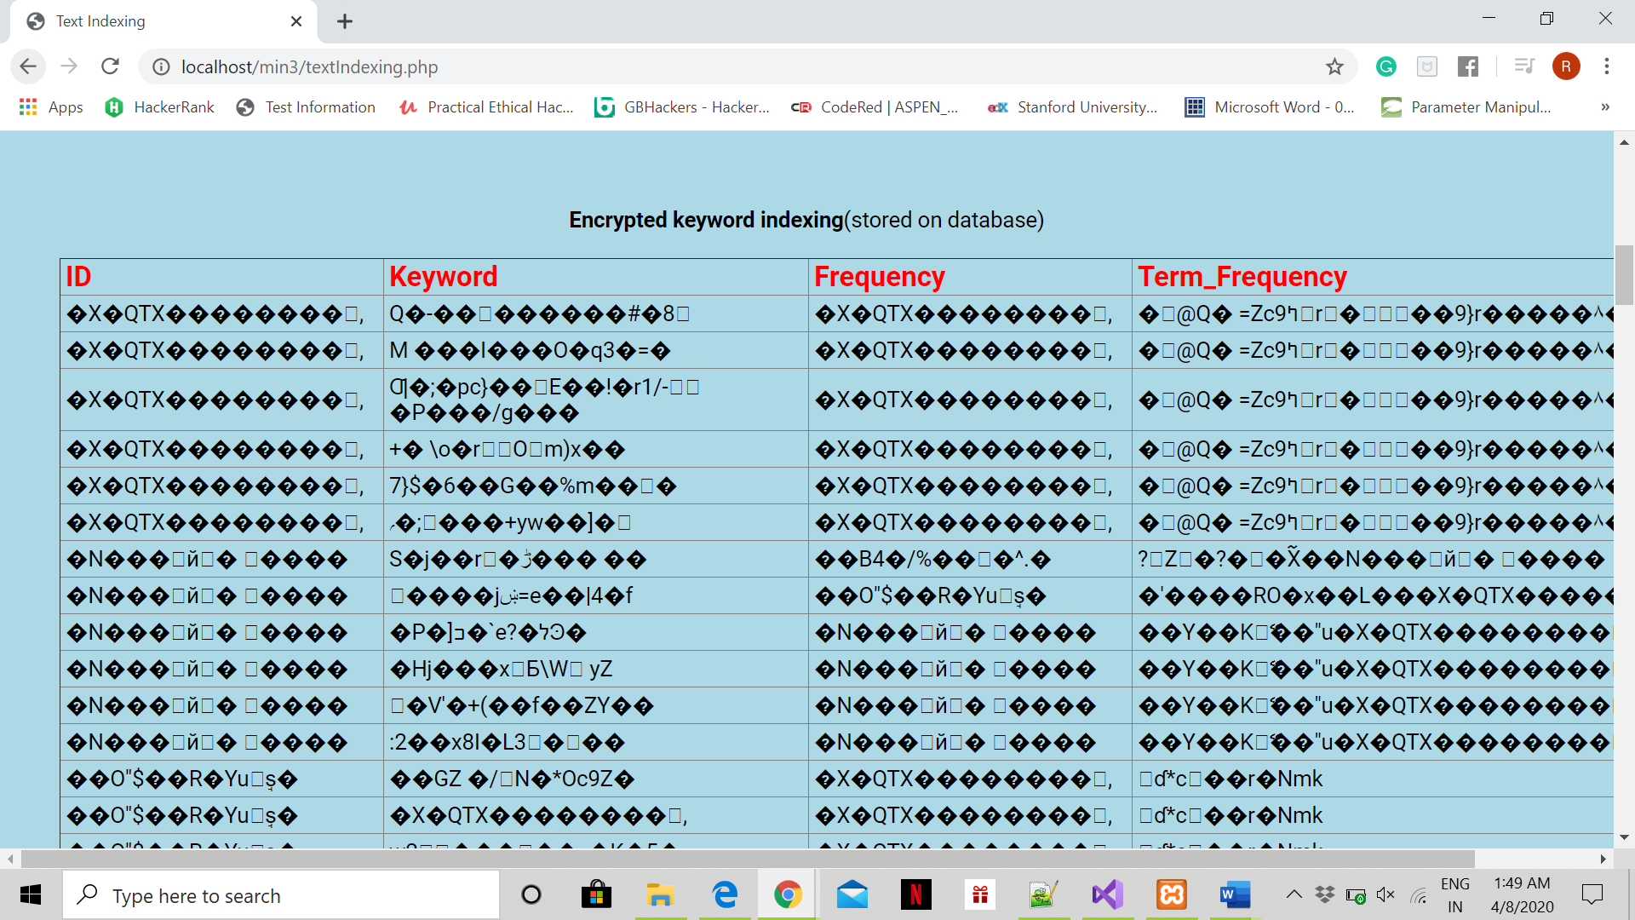
OUTPUT SCREEN
3. textindexing.php- The extracted encrypted keywords are stored to database tables. The structure of keyword storage table and file storage table and its associated data is as follows:

Slide 20
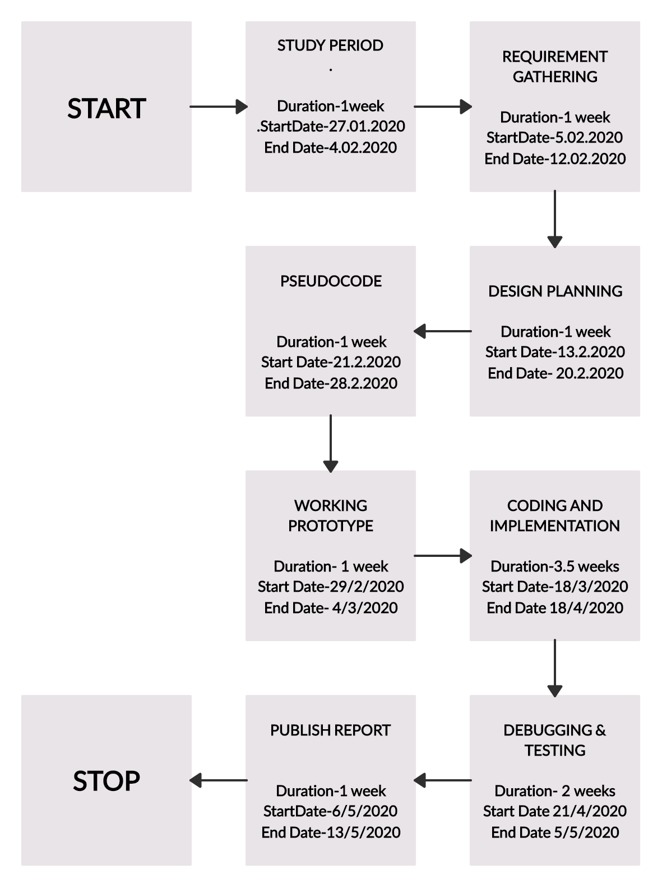
PERT CHART

